Slide 1
IOT NETWORKING FOR SAFETY AND COMFORT IN SMART VEHICLES
AKANKSHA MAHAJAN
ANUSHA ALLU
SAMPATH YELCHURI
Notes:
Good evening evry1 present here.
My name is Sampath, she is anusha and she is akansha
and today , we are here to present our research on IoT Networking for Safety and Comfort in Smart Vehicles.
So, lets get started.

Slide 2
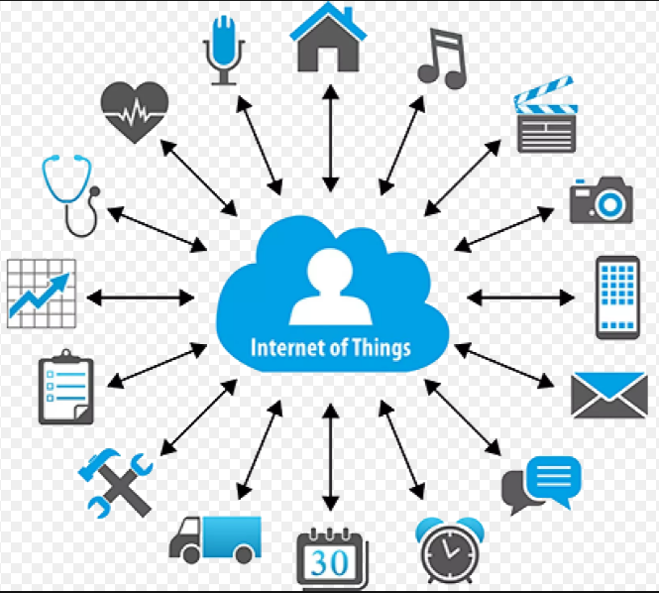
INTRODUCTION TO IOT AND SMART VEHICLES
What is Internet of Things ?
Internet of Things (IoT) is basically defined as a combination or collection of smart devices which communicate which each other in a wireless network.
What is a Smart Vehicle ?
A Smart Vehicle can be defined as Connected Vehicle which is designed with whole lot of IoT devices whose primary motive is to increase the travel experience of driver(s) or passenger(s).
Notes:
Lemme first define the two new terms which are stated in the title of our research:
IoT and Smart Vehicles.
So what is IOT: The term IoT is defined as the a collection or combination of Smart devices or Smart Systems which use internet as medium for the purpose of wireless communication.
And What is a Smart Vehicle: A Smart vehicle can be defined as a intelligent vehicle which is designed using Samrt devices that offers a good travel experice to its user by coordinating with itself.

Slide 3
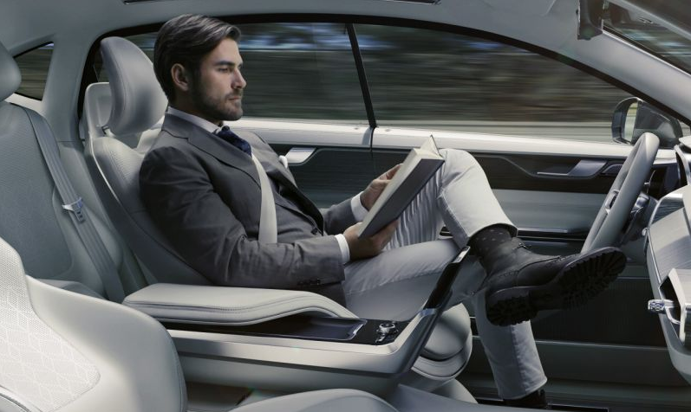
SAFETY AND COMFORT IN SMART VEHICLES
Whenever a Smart Vehicle comes into the picture, everyone focus on the easy travel and smart features that a Smart Vehicle provides its user(s).
But it equally important and a challenging task to design a Smart Vehicle which provides comfortness and maintains safety of all the passengers travelling in it.
Notes:
So, The main obective of introducing the concept of Smart Vehicle is to increase the driving experience and ensure the comfortness and safety of the user and passengers.

Slide 4
RESEARCH QUESTIONS
Our research mainly focuses on how :
Research Question 1: How to provide Comfort and Safety of all passengers in Smart Vehicle?
Research Question 2: How to improve failure recovery in Smart car when loss of network?
Research Question 3: How to use Artificial Intelligence and Data Analytics to quickly respond to recovery of failure?
Research Question 4: How can Smart Vehicles improve Child Safety and Comfort?
Notes:
So, these are the following reseach questions that we have worked upon in this reseach that are:
-----
So, now akasha is going to dicuss about research question 1 re;ated to comfort and safety for passengers in a Samrt Vehicle?
-----

Slide 5
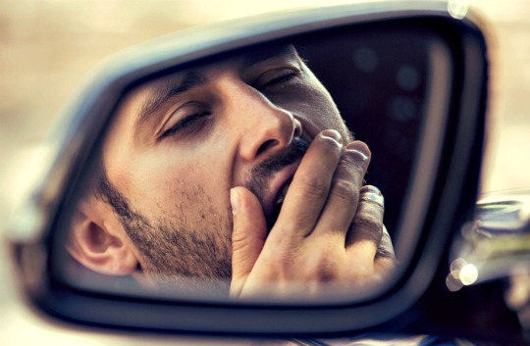
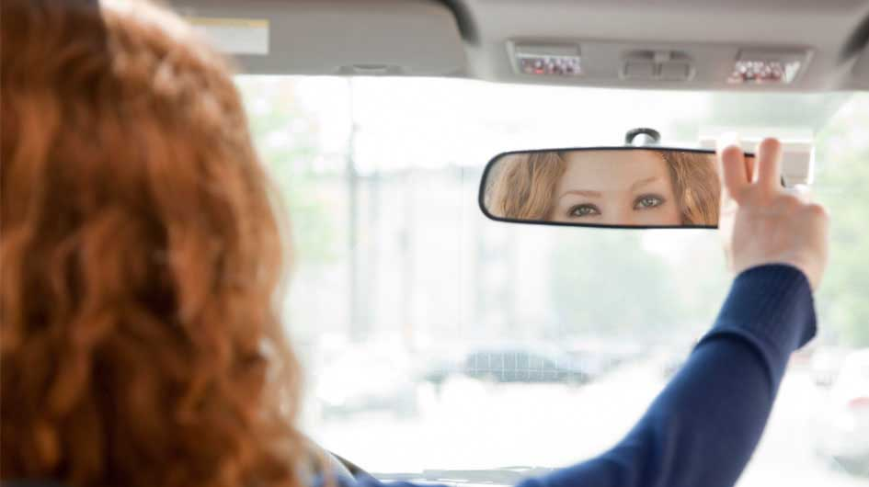
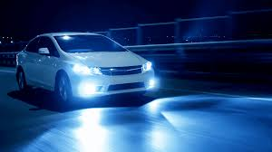
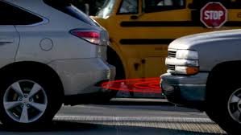
Safety and Comfort Features
The coolest infotainment thing is provide display and tell the name of the song playing on radio
Automatic -> Autonomous
Tell me when to take rest
Set Rear View Mirror for me
Have Adaptive headlights and auto switch of high-low beam
Warn me when I am about to collide from the front
Smart Monitoring
Smart Sensing
Smart Analytics

Slide 6

Failure Recovery in Case of Network Loss
Whenever there is a failure of an IoT device in a Smart Vehicle, it basically stops to communicate with other IoT devices connected to it.
And without communication between the IoT devices, there is a possibility that the coordination of the entire system may fail.
This failure of the system result in discomfortness to the user and sometimes may also lead to some crashes.
Notes:
So, whenever, there is a failure in an IoT device or a grp of smart devices, then they may fail to communicate with one another.
This failure in communication may lead to failure in the coorsination of the entire system which may inturn result in discomfortness to the user and sometimes lead to some accidents as well.

Slide 7
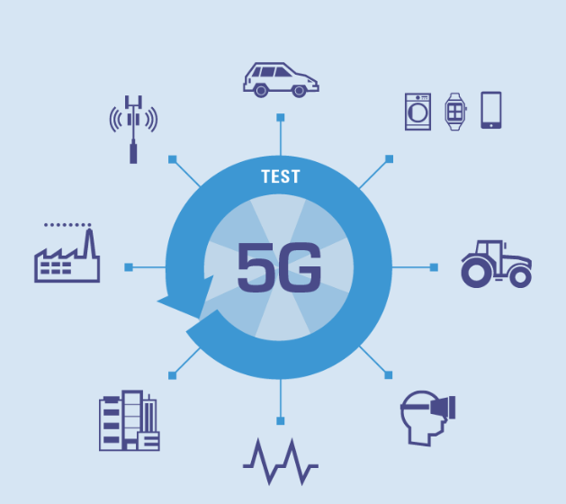
Failure Recovery in Case of Network Loss (Cont.)
So, the main question is, how can recover from these kind of failures and provide Comfortness and maintain Safety of user(s) and passenger(s)?
One possible solution is usage of the following technologies:
Vehicular Ad-hoc Networks (VANETS).
The Emerging 5G Network.
Mobile Edge Computing
Notes:
So, in such a situation, how can we recover from the failure and maintain the comfortness of the user in the Smart Vehicle.
This can be resolved by using two emerging technologies which are
-> VANETS
--> 5G

Slide 8
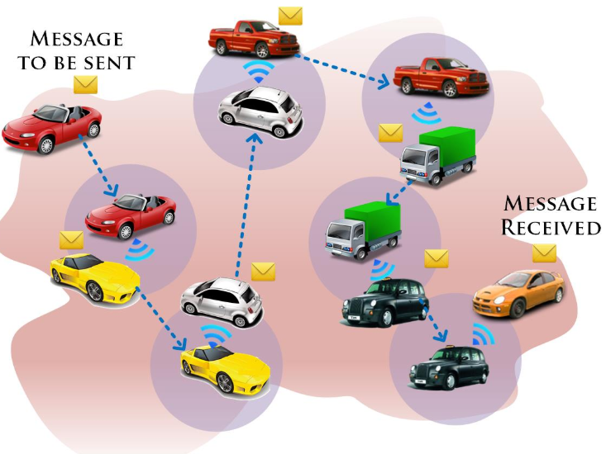
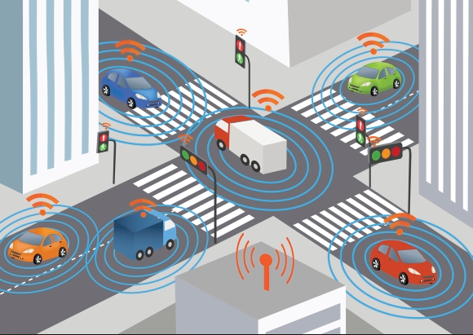
Failure Recovery in Case of Network Loss (Cont.)
With the help of VANETS, we can re-establish communication by exchanging data or information with nearby Smart Vehicles. This kind of communication technique is known as Vehicle to Vehicle Communication (V2V).
Another way of re-establishing communication is by communicating with the IoT devices which reside in a Smart City such as Traffic Lights, Smart Building etc., This kind of communication technique is known as Vehicle to Infrastructure Communication or Vehicle to Roadside Communication (V2I) .
Notes:
Explain about (VANETS--->V2V and V2I)

Slide 9
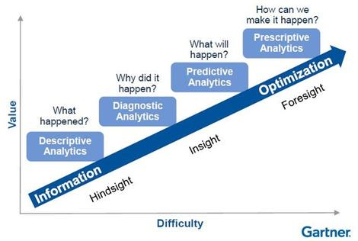
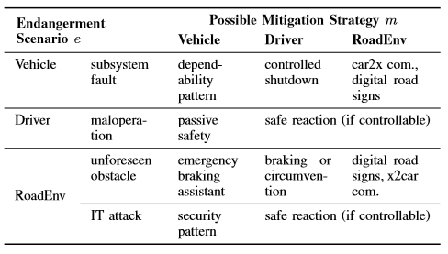
Artificial Intelligence and Data Analysis in case of failure
AI makes the machine learn fast
Apparently a car can learn to drive itself in 15-20 mins

Slide 10
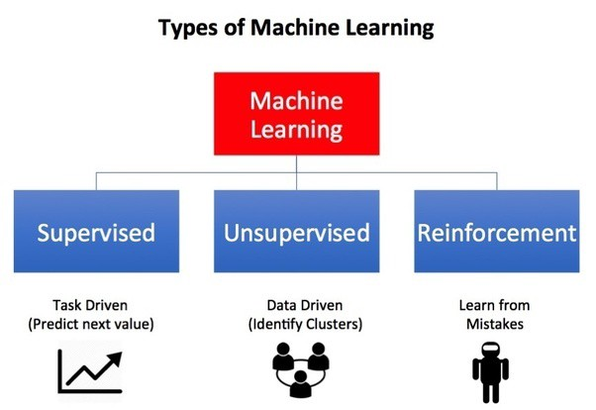
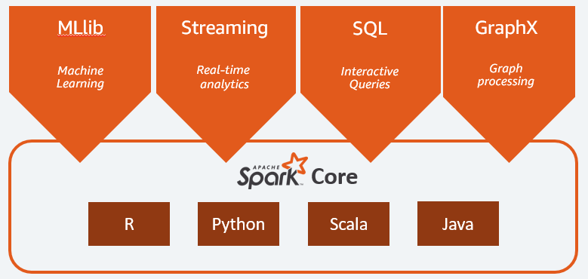
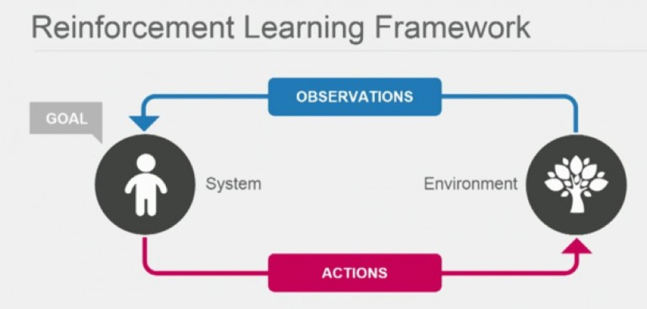
Artificial Intelligence and Data Analysis
With AI a car can learn driving within 20 mins -- at least the basic driving -- using Reinforcement Learning Algorithm

Slide 11

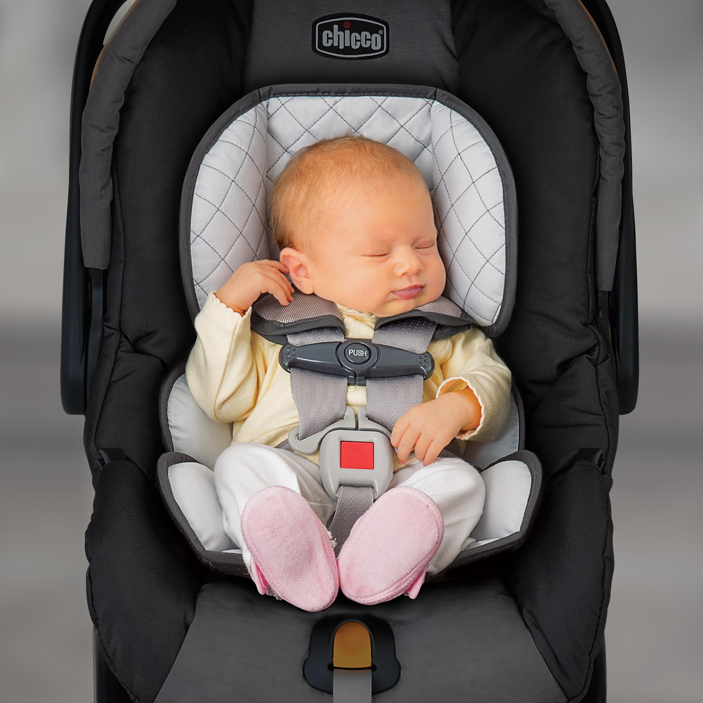
CHILD SAFETY AND COMFORT
To provide safety and comfort for children, we should look into two aspects:
Reason behind baby discomfort while driving.
Driving cautiously to provide safety of passengers.

Slide 12

CHILD SAFETY AND COMFORT (Cont.)
Monitoring system for baby:
Baby monitoring system acts as a entertainment device, it has a camera, a thermo coolant system and can sense surrounding temperature. Driver monitor system gets alerts when:
Seat belt is not buckled properly
Baby is trying to remove seat belt
There is some abnormality in breathing of the child
Baby’s diaper is soiled/full
Driver’s monitor can get alerts when baby feels discomfort and alerts like “BABY ON BOARD,GO SLOW!”
Smart seat belt of parent can detect if driver is drowsy.
Parent gets alerts in mobile if child is forgotten in the car

Slide 13
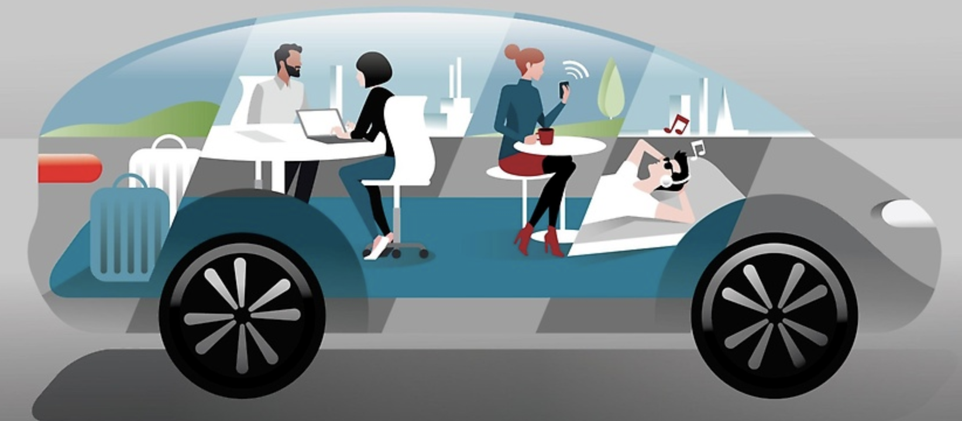
CHILD SAFETY AND COMFORT (Cont.)
Driver assist cars and driver autonomous cars.
Using AI,HCI safety and comfort of passengers have increased.
Brain Computing Interaction(BCI) can be used in autonomous vehicles
High level of interactivity.
Design interior of car as our wish.
No physical interface.

Slide 14

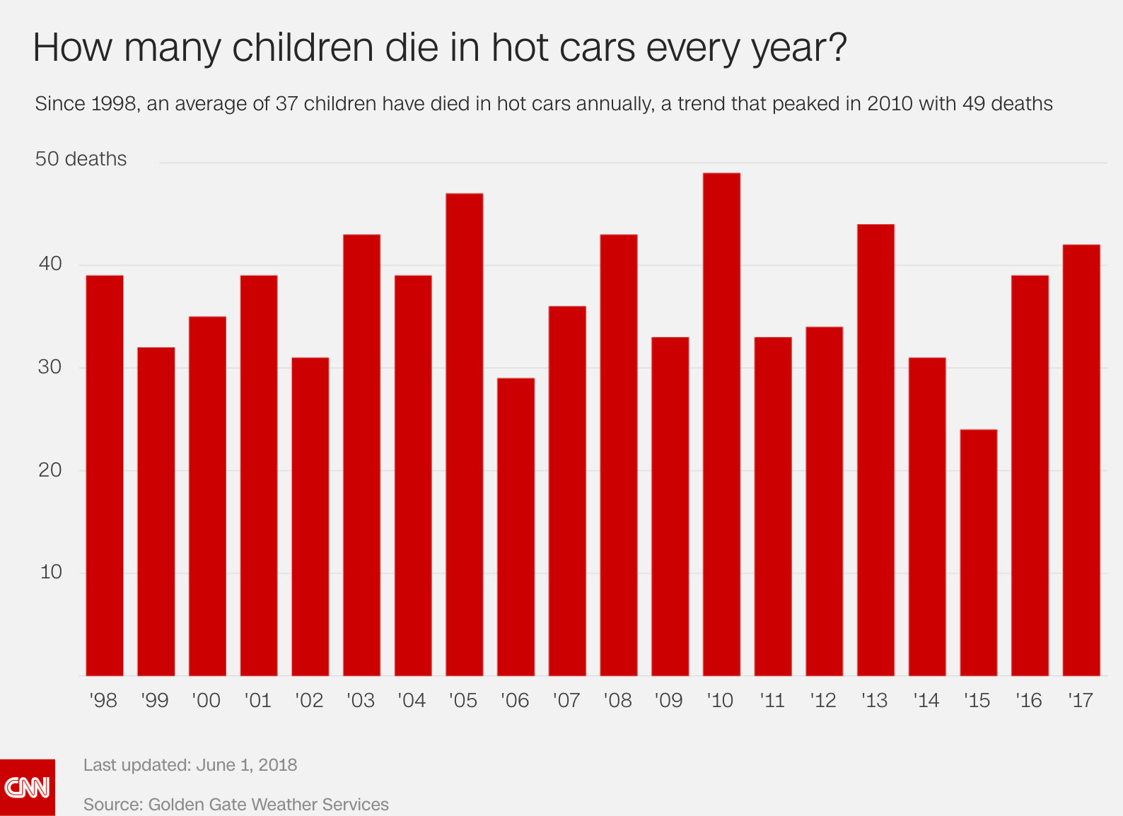
CASE STUDY-
CHILD SAFETY IN PARKED VEHICLES

Slide 15
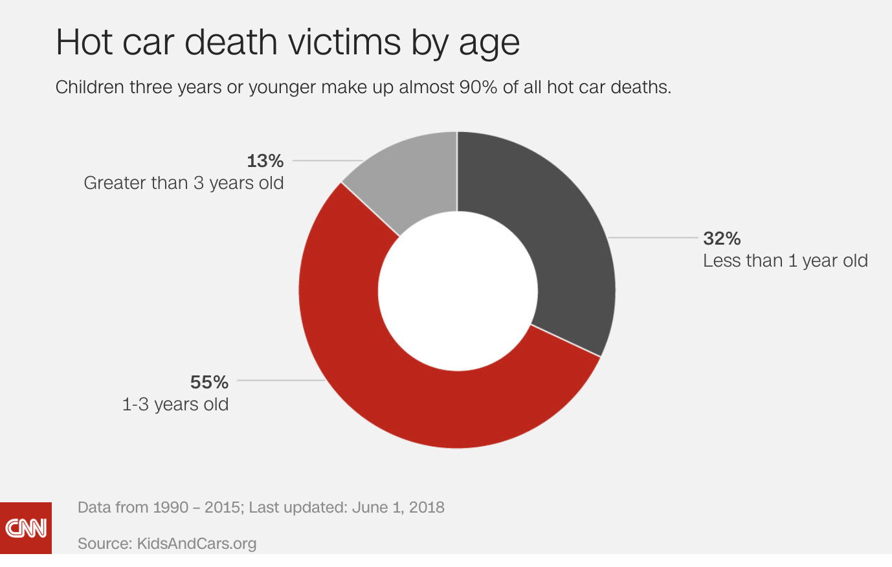
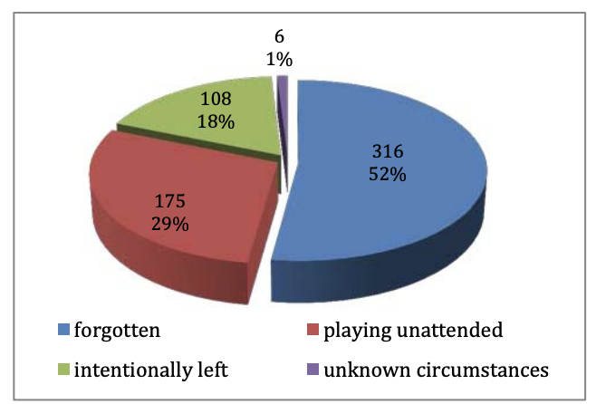
CASE STUDY (Cont.)
36 children die every year in hot cars because of hyperthermia
Temperature in car can raise by 10 to 15 degrees within 15-20 minutes
Proposed solution can save the child from heat strokes
AI, BCI can look after safety of the babies

Slide 16
CONCLUSION
Safety and Comfort are the foremosts issue in vehicles and it is most critical because the communication is mobile.
With the help of VANETS and the newly emerging 5G network, we can recover from a loss of network and provide comfort & safety of user(s).
Implementing AI Reinforcement algorithms and using Spark for Real time Data Analytics will help reduce response time in case of failure in Smart Vehicles, and the response time will be better with more training/learning and in presence of 5G networks.
There is a need to provide safety for babies in vehicles.
Smart vehicles can become temporary caretakers and take care of the babies

Slide 17
Thank You

